Slide 1

BACKORDER

Slide 2
PROBLEM STATEMENT:
It is a business problem statement.It is involved in classifying the products whether they would go into backorder(yes or no) based on the historical data from inventory, supply chain and sales.

Slide 3
TYPES OF FEATURES
DEPENDENT FEATURES
INDEPENDENT FEATURES

Slide 4
DEPENDENT FEATURE
They are 23 features in this dataset among this 23 features only one feature is dependent feature that is ‘went_on_backorder’.The value in this feature is one among this i.E ‘yes’ or ‘no’.
‘Yes’ implies that a particular product may goes backorder
‘No’ implies that a particular product won’t go for backorder

Slide 5
INDEPENDENT FEATURES
Remaing all 22 features are independent features.They are
Sku - random ID for the product
National_inv - current inventory level for the part
Lead_time - transit time for product (if available)
In_transit_qty - amount of product in transit from source
Forecast_3_month - forecast sales for the next 3 months
Forecast_6_month - forecast sales for the next 6 months
Forecast_9_month - forecast sales for the next 9 months
Sales_1_month - sales quantity for the prior 1 month time period
Sales_3_month - sales quantity for the prior 3 month time period
Sales_6_month - sales quantity for the prior 6 month time period

Slide 6
sales_9_month - Sales quantity for the prior 9 month time period
min_bank - Minimum recommend amount to stock
potential_issue - Source issue for part identified
pieces_past_due - Parts overdue from source
perf_6_month_avg - Source performance for prior 6 month period
perf_12_month_avg - Source performance for prior 12 month period
local_bo_qty - Amount of stock orders overdue
deck_risk - Part risk flag
oe_constraint - Part risk flag
ppap_risk - Part risk flag
stop_auto_buy - Part risk flag
rev_stop - Part risk flag

Slide 7
PREPROCESSING STEPS
HANDLING THE NULL VALUES
REMOVING THE OULIERS

Slide 8
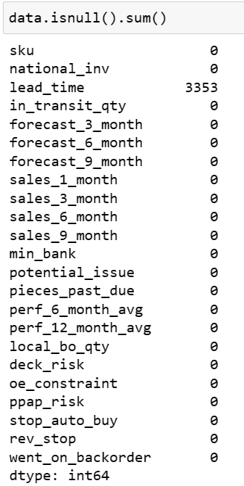
HANDLING THE NULL VALUES
In this data set we have null values in only one feature that is ‘lead_time’.

Slide 9
TECHNIQUES IN HANDLING NULL VALUES
Deleting the columns/rows with missing data
Filling the missing data with a value- imputation
Imputation with an additional column
In this we followed first technique as the missing values are very less.
So we deleted all the rows which has missing values.
Code:
Data['lead_time'].Dropna(inplace=true)

Slide 10
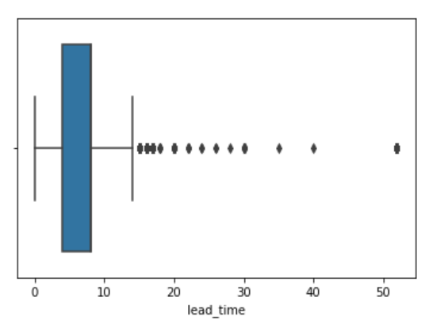
HANDLING THE OUTLIERS
An outlier is an observation that lies abnormally far away from other values in a dataset. Outliers can be problematic because they can affect the results of an analysis.
To identify the outliers
Use the interquartile range.
Use z-scores
We used boxplot to identify the outliers.The outliers are present in ‘lead_time’ column.

Slide 11
EXPLORATORY DATA ANALYSIS

Slide 12
TYPES OF ANALYSIS
Univariate Analysis
Bivariate Analysis
Multivariate Analysis

Slide 13
Univariate analysis
The term univariate analysis refers to the analylsis of one variable.

Slide 14
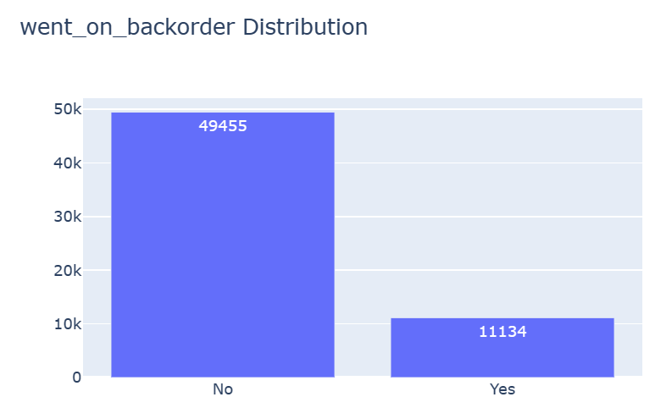
Distribution of went_on_backorder
Among 60589 items 11134 items were back ordered

Slide 15
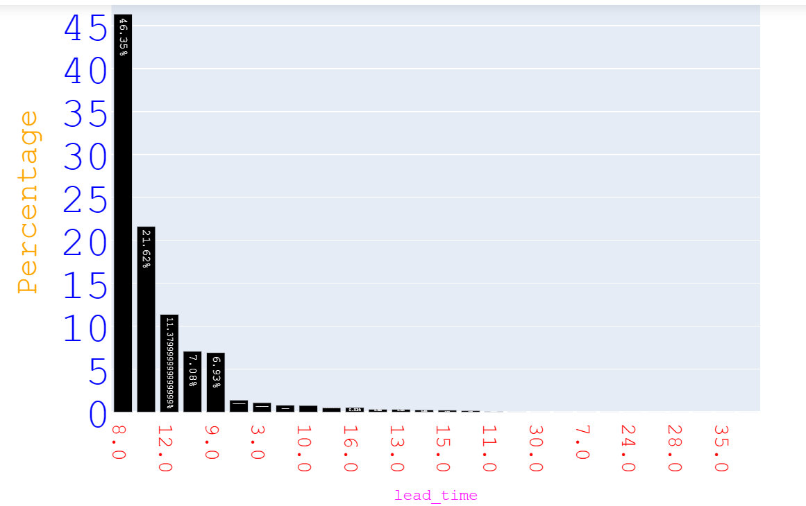
Distribution of lead_time

Slide 16
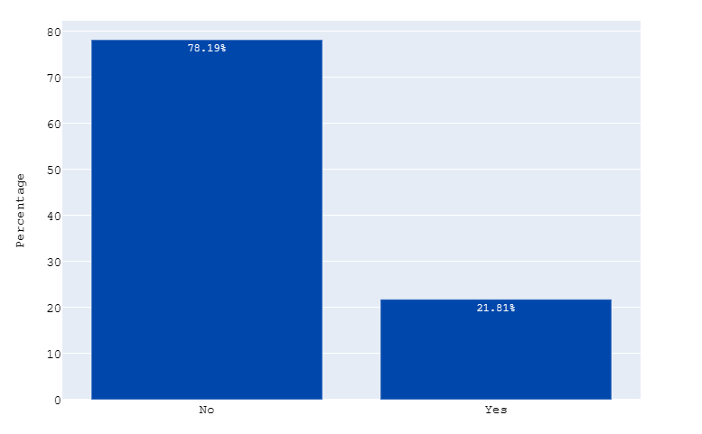
Distribution of deck_risk
DEC RISK COLUMN

Slide 17
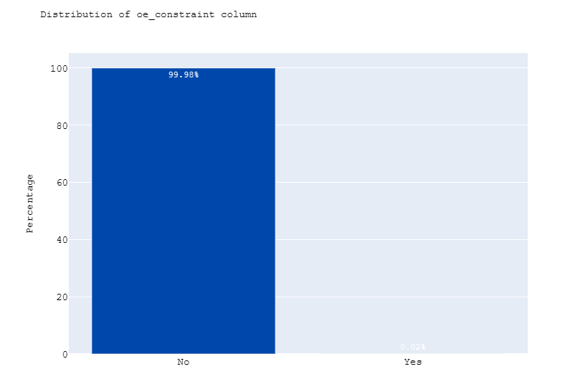
Distribution of oe_constraint

Slide 18
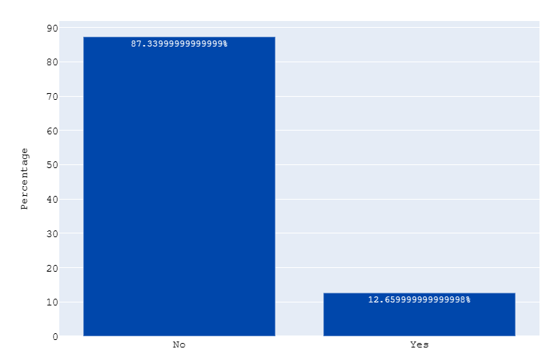
Distribution of ppap_risk

Slide 19
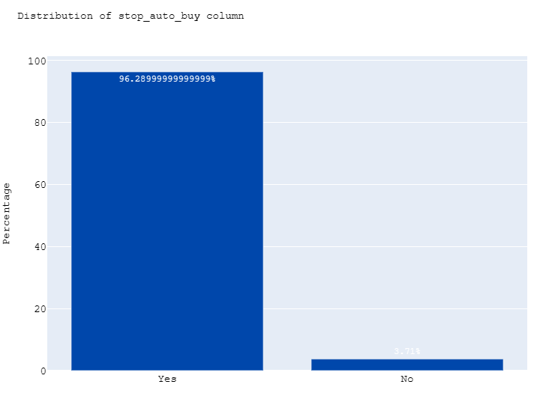
Distribution of stop_auto_buy

Slide 20
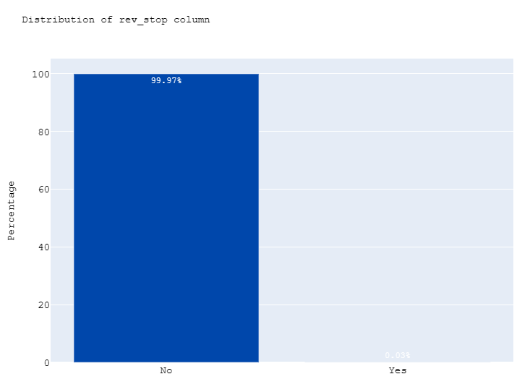
Distribution of rev_stop

Slide 21
BIVARIATE ANALYIS
Bivariate data analysis is a statistical test that involves two separate variables. It is used to determine whether or not two variables are related.

Slide 22
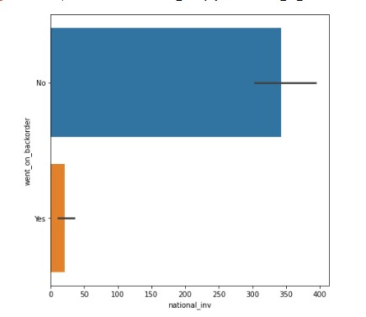
went_on_backorder vs national_inv
The more the national_inv the less the products went on back order.

Slide 23
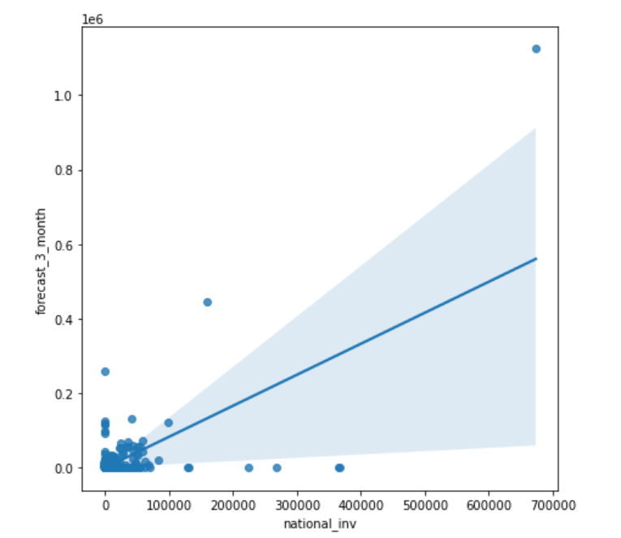
national_inv vs forecast
national_inv feature is some what positively related to forecast.

Slide 24
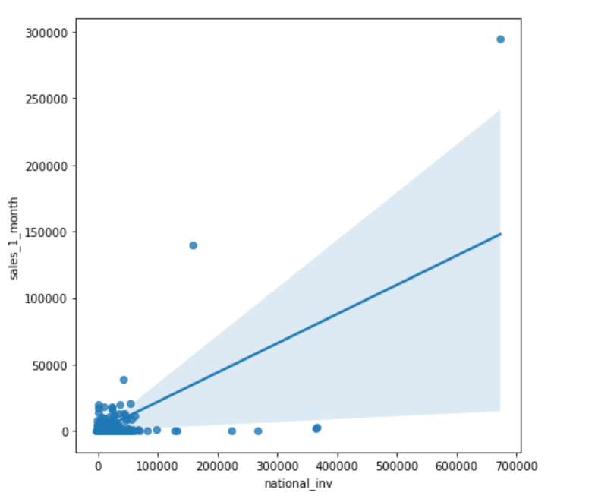
national_inv vs sales
Their some positively relation between national_inv and sales

Slide 25
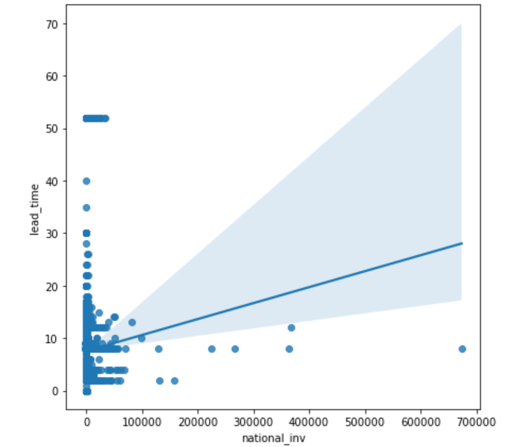
national_inv vs lead_time
Their some positive relation between lead_time and national_inv.

Slide 26
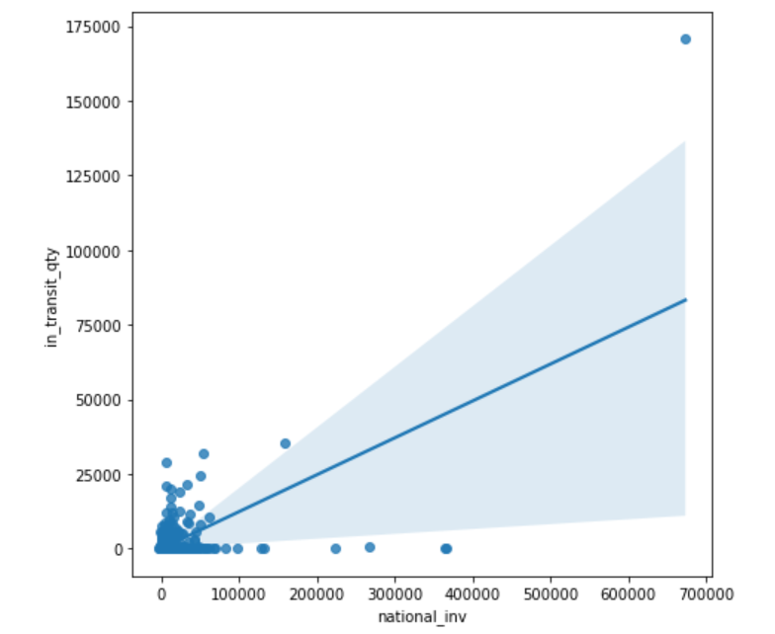
national_inv vs in_transit_qty
Their some positive relation between in_transit_qty and national_inv

Slide 27
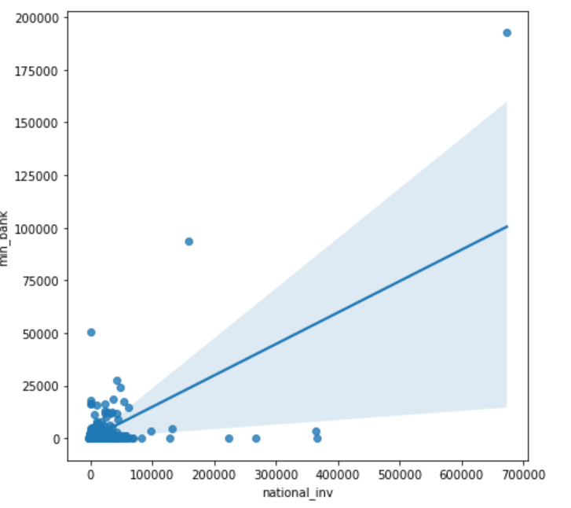
national_inv vs in_min_bank
Their some positive relation between min_bank and national_inv

Slide 28
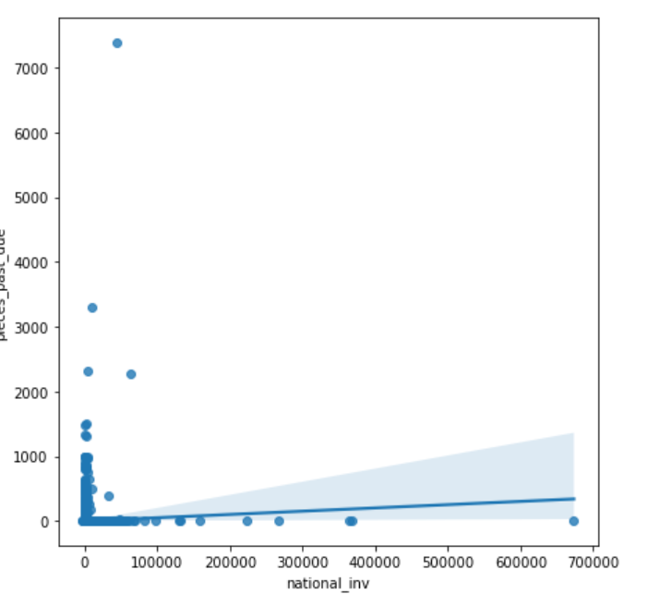
national_inv vs pieces_past_due
There is very less relation between national_inv and pieces_past_due

Slide 29
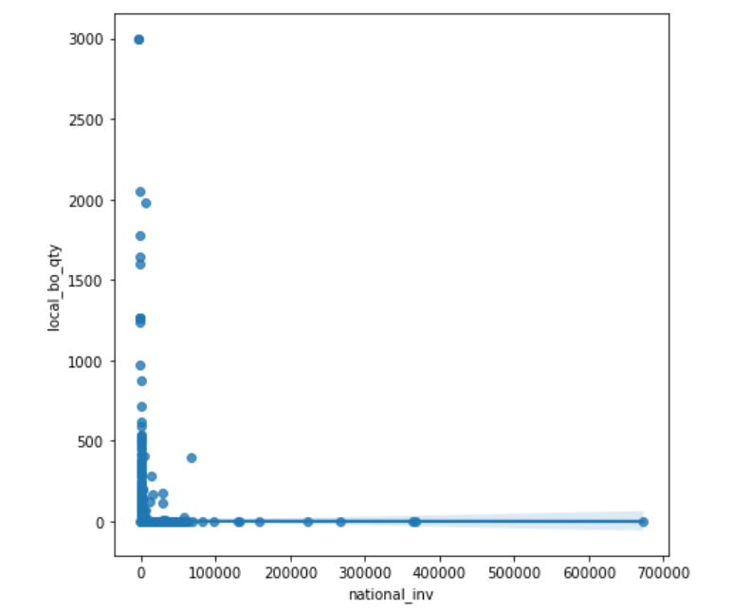
national_inv vs local_bo_qty
There is no relation between national_inv and local_bo_qty

Slide 30
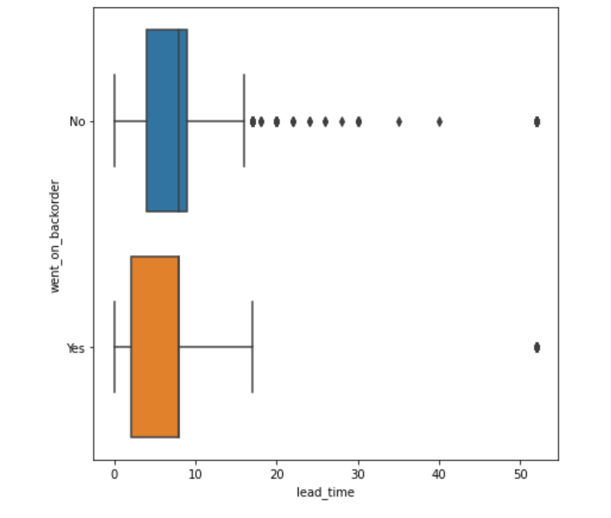
Went_on_backorder vs lead_time

Slide 31
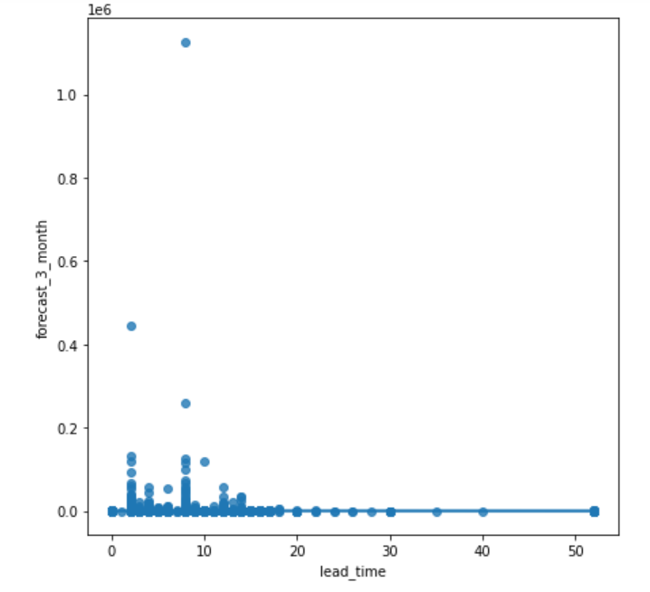
Lead_time vs forecast
There is no relation between lead_time and forecast.

Slide 32
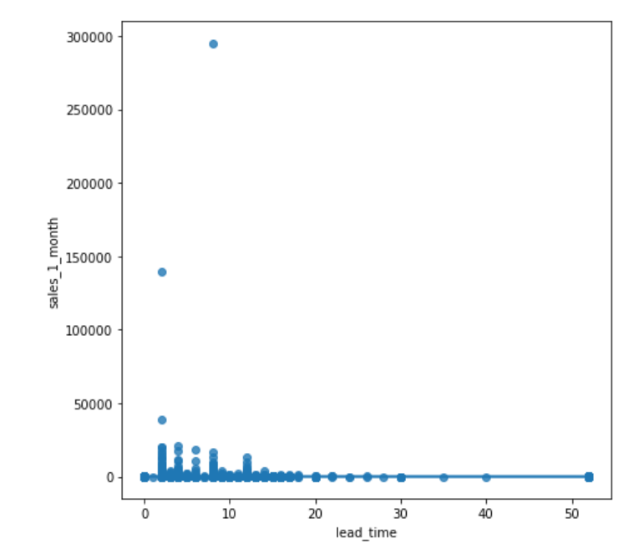
Lead_time vs sales
There is no relation between lead_time and sales.

Slide 33
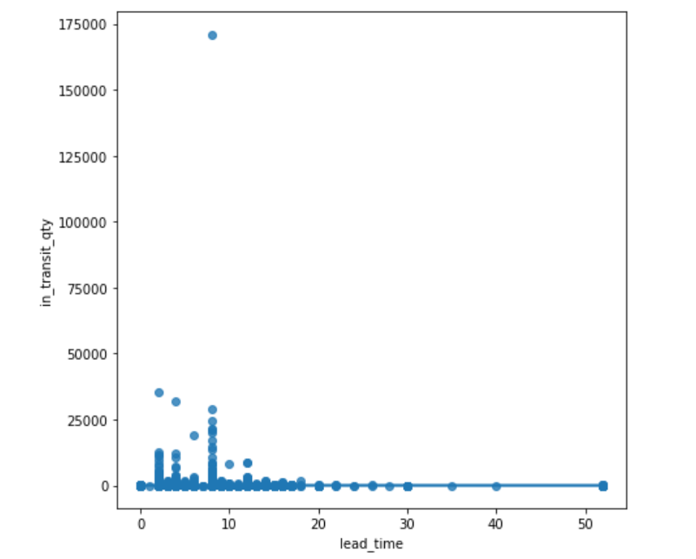
lead_time vs in_transit_qty
There is no relation between lead_time and in_transit_qty.

Slide 34
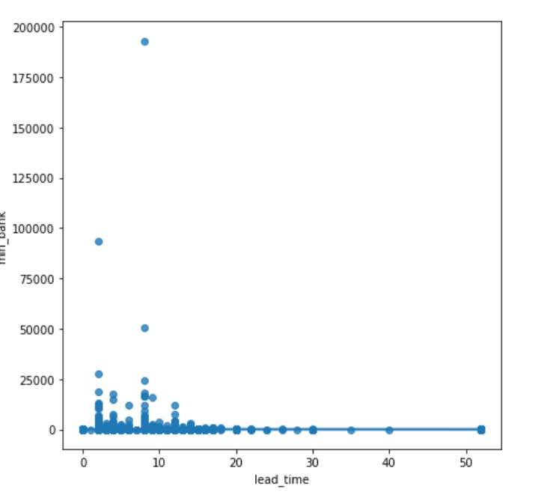
lead_time vs min_bank
There is no relation between lead_time and min_bank.

Slide 35
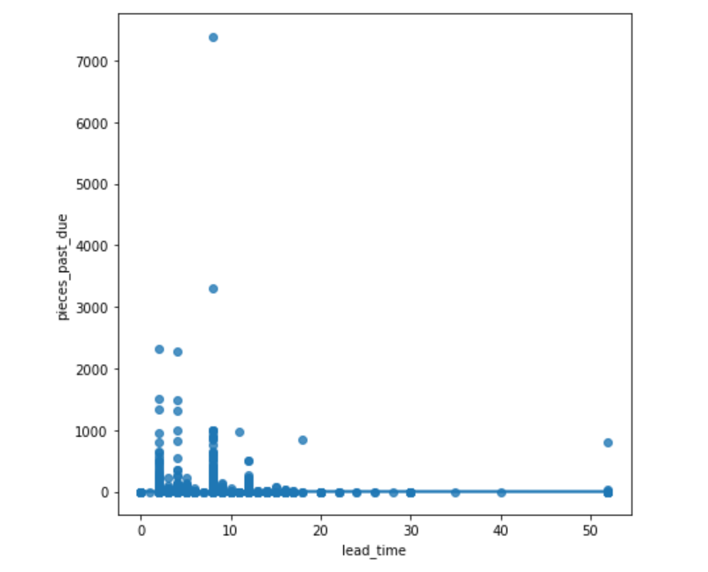
lead_time vs pieces_past_due
There is no relation between lead_time and pieces_past_due.

Slide 36
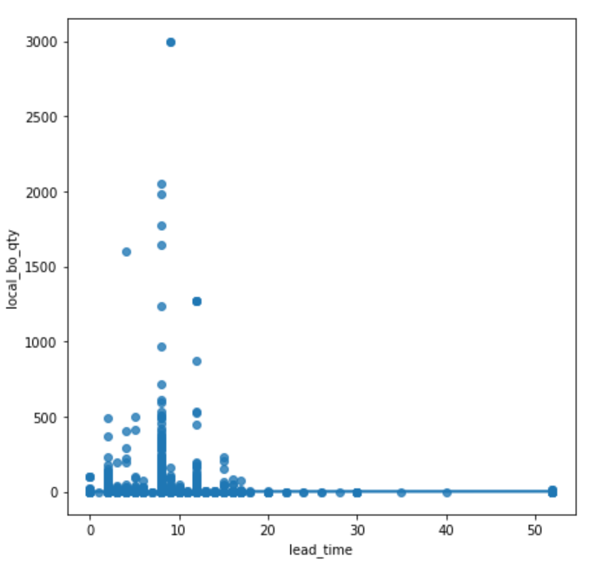
lead_time vs local_bo_qty
There is no relation between lead_time and local_bo_qty.

Slide 37
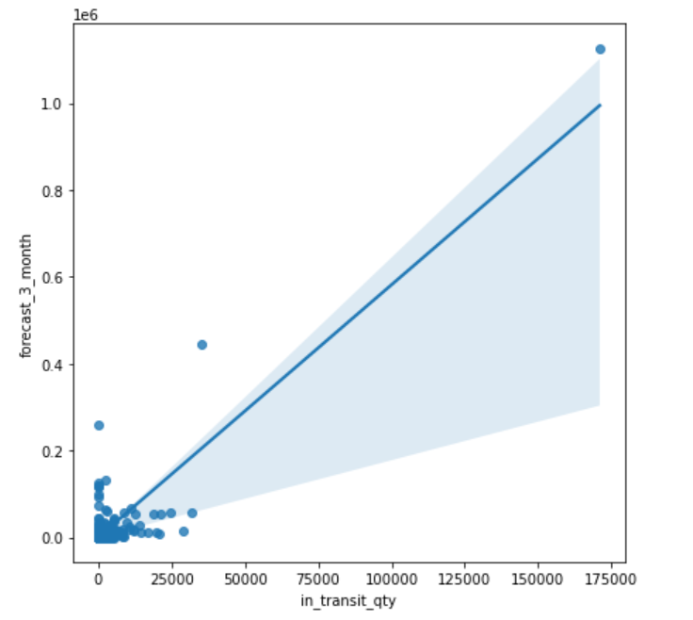
in_transit_qty vs forecast
There is some positive relation between in_transit_qty and forecast.

Slide 38
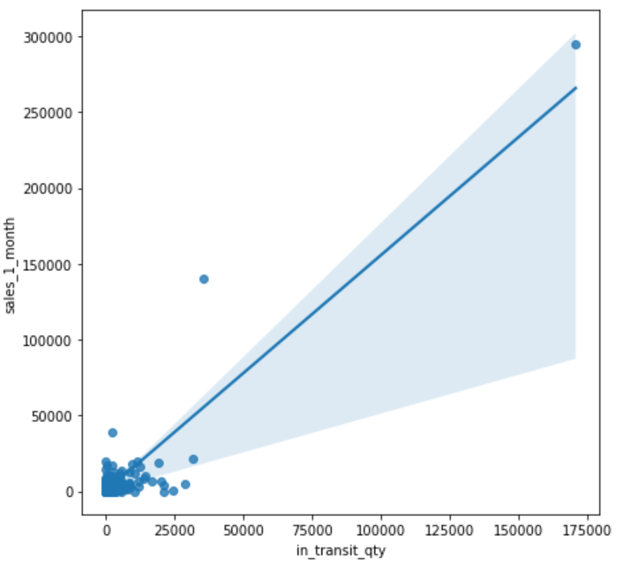
in_transit_qty vs sales
There is some positive relation between in_transit_qty and sales.

Slide 39
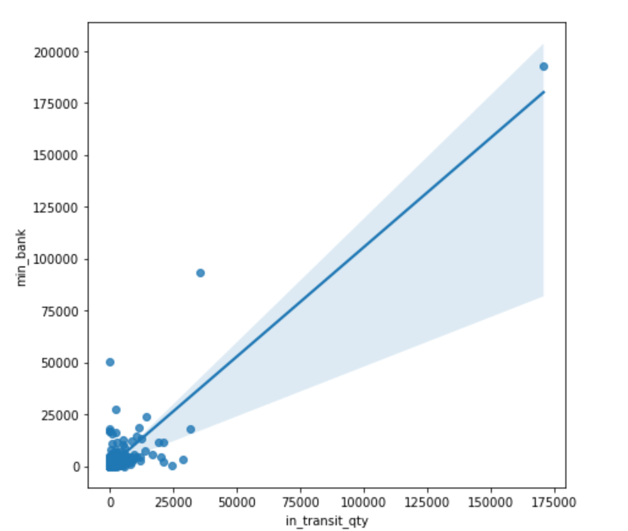
in_transit_qty vs min_bank
There is some positive relation between in_transit_qty and sales.

Slide 40
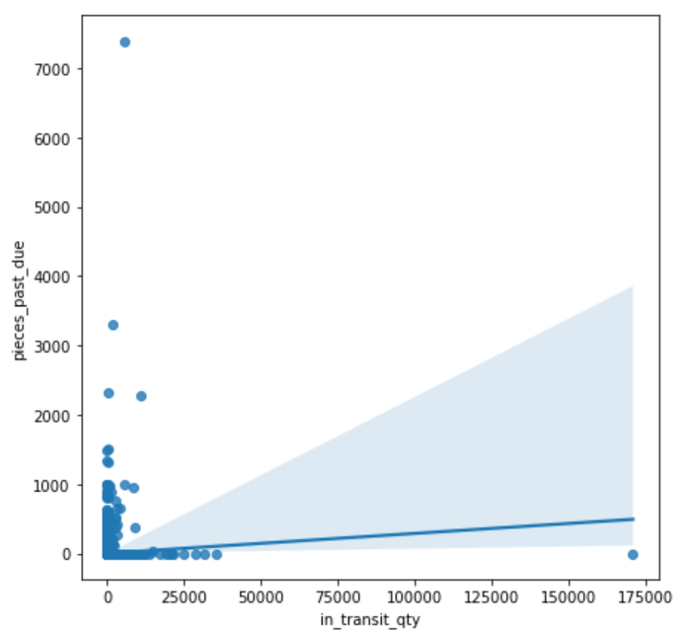
in_transit_qty vs pieces_past_due
There is very less positive relation between in_transit_qty and sales.

Slide 41
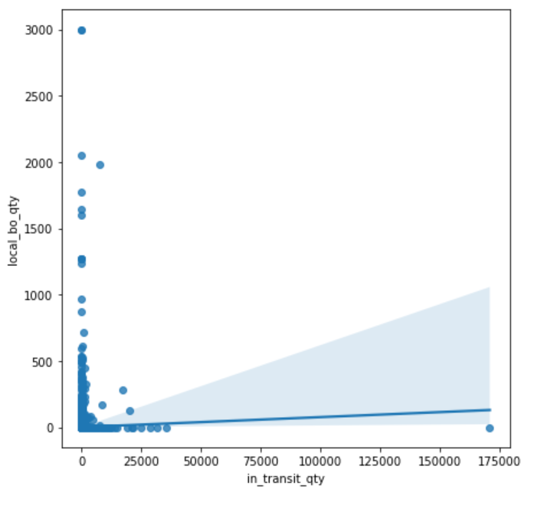
in_transit_qty vs local_bo_qty
There is very less positive relation between in_transit_qty and sales.

Slide 42
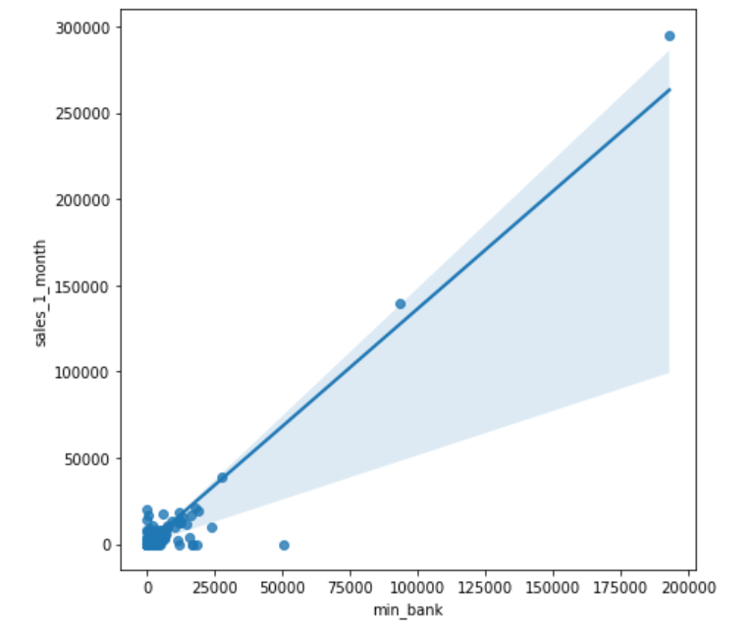
Min_bank vs sales
There is positive relation between min_bank and sales.

Slide 43
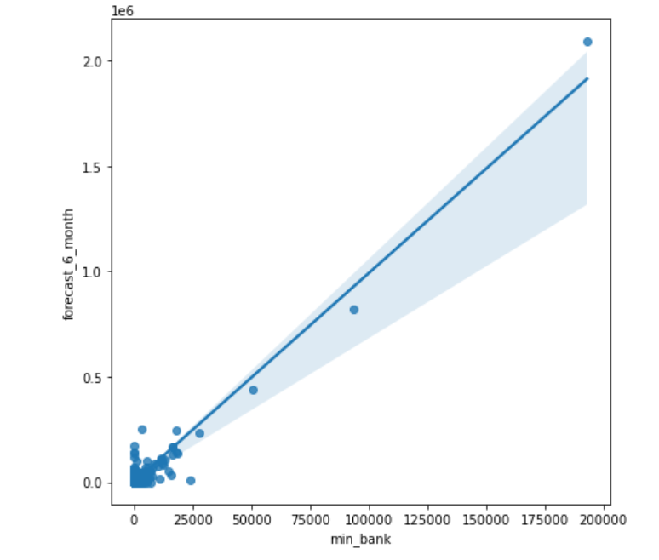
Min_bank vs forecast
There is positive relation between min_bank and forecast.

Slide 44
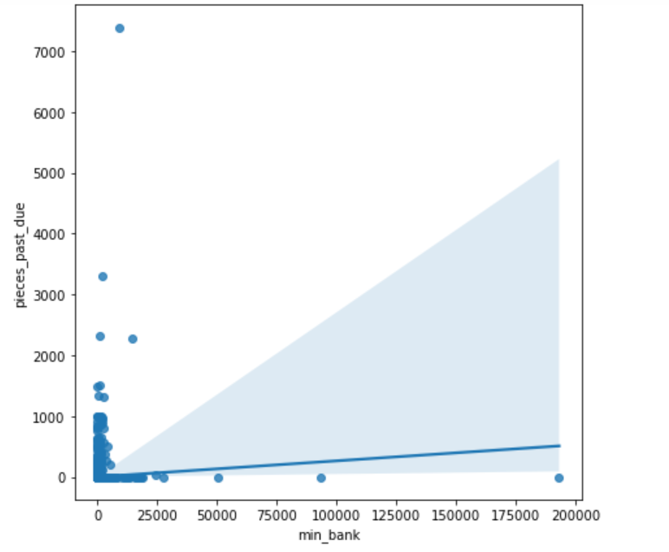
Min_bank vs pieces_past_due
There is very less positive relation between min_bank and pieces_past_due.

Slide 45
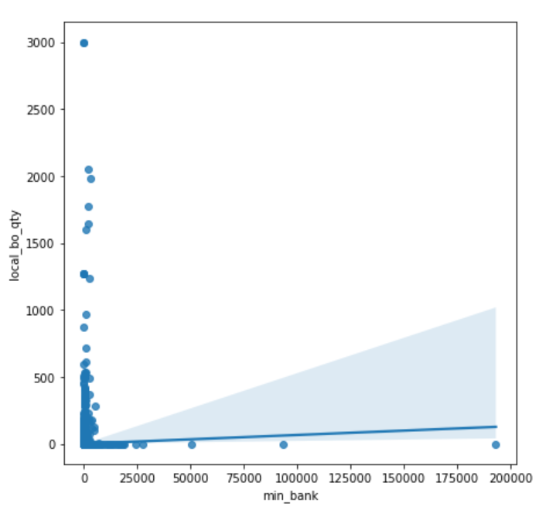
Min_bank vs local_bo_qty
There is very less positive relation between min_bank and local_bo_qty.

Slide 46
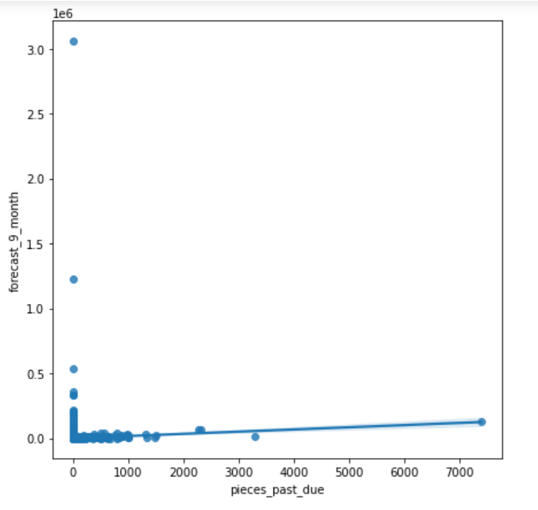
Pieces_past_due vs forecast
There is very less positive relation between pieces_past_due and forecast.

Slide 47
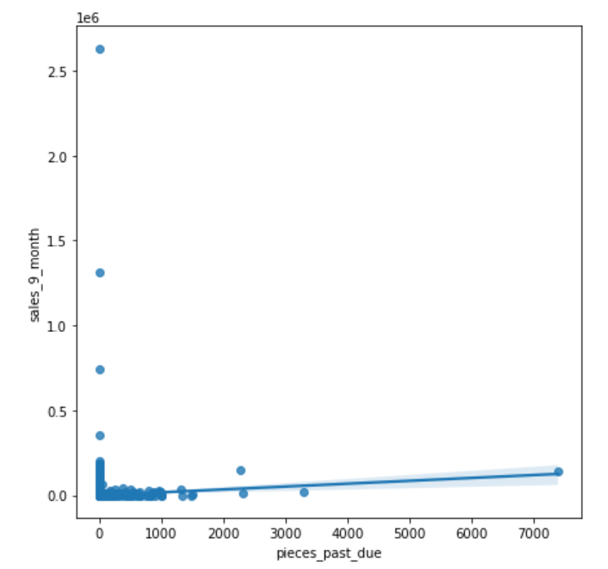
Pieces_past_due vs forecast
There is very less positive relation between pieces_past_due and sales.

Slide 48
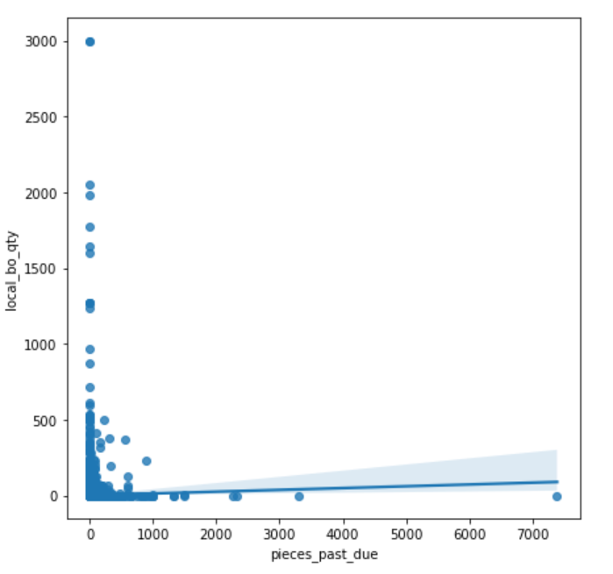
Pieces_past_due vs local_bo_qty
There is very less positive relation between pieces_past_due and sales.

Slide 49
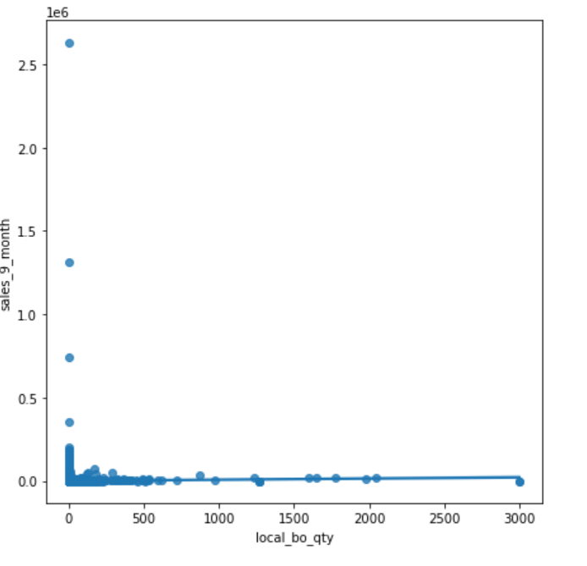
local_bo_qty vs sales
There is no relation between local_bo_qty and sales.

Slide 50
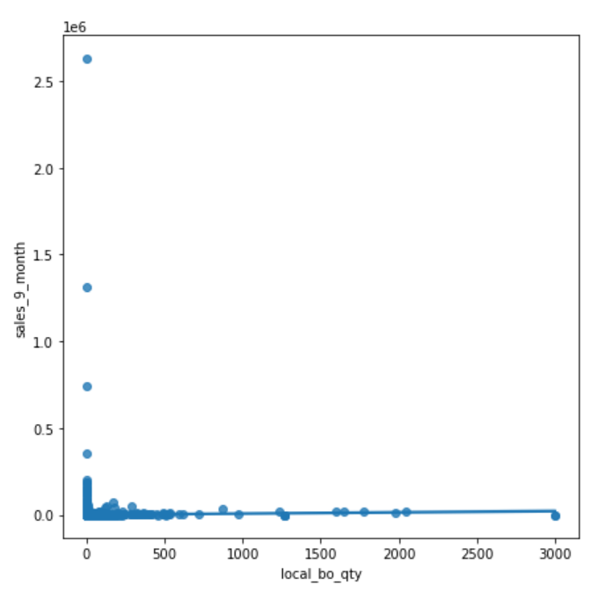
Sales vs local_bo_qty

Slide 51
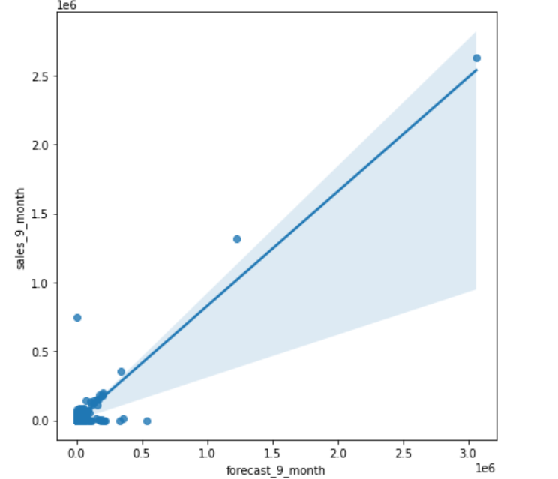
Sales vs forecast
There is directly relation between sales and forecast.

Slide 52
MULTIVARIATE ANALYSIS
Multivariate analysis is concerned with the interrelationships among several variables.

Slide 53
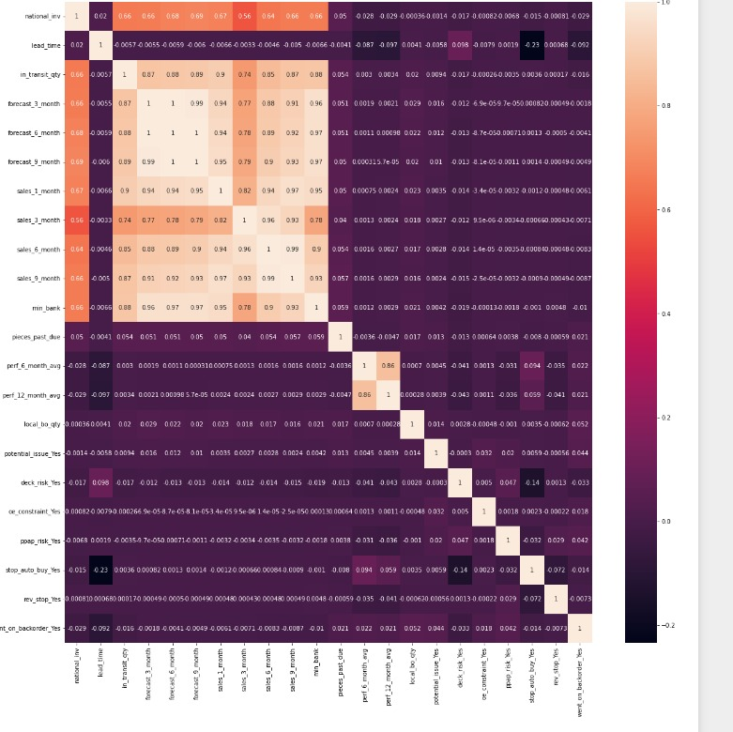

Slide 54
ABOUT CORRELATION
If the correlation coefficient value of any two features is positive then they are directly proportional each other.
If the correlation coefficient value of any two features are negative then they are inversely propotional to each other.
If the correlation coefficient is zero than they are not related to each other that is one is independent on the other.

Slide 55
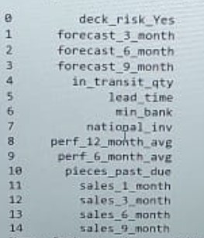
CONCLUSION
From the heat map the variables which directly and inversely related to target variables are

